Slide 1
VAE with Full Covariance
Presenter: Kim Seung Hwan (overnap@khu.ac.kr)

Slide 2
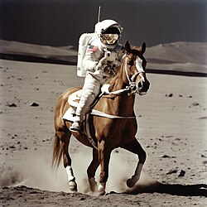
Why does LDM works well?
Latent Diffusion Model a.k.a. Stable Diffusion
Rombach, Robin, et al. "High-resolution image synthesis with latent diffusion models." Proceedings of the IEEE/CVF conference on computer vision and pattern recognition. 2022.
Works nicely!!!

Slide 3
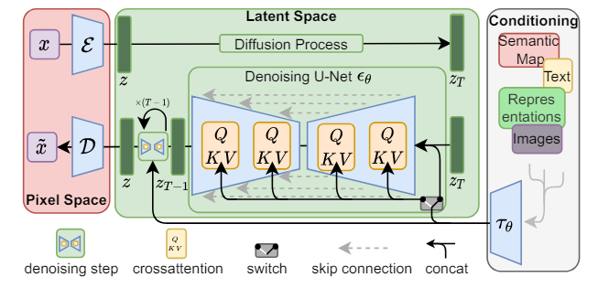
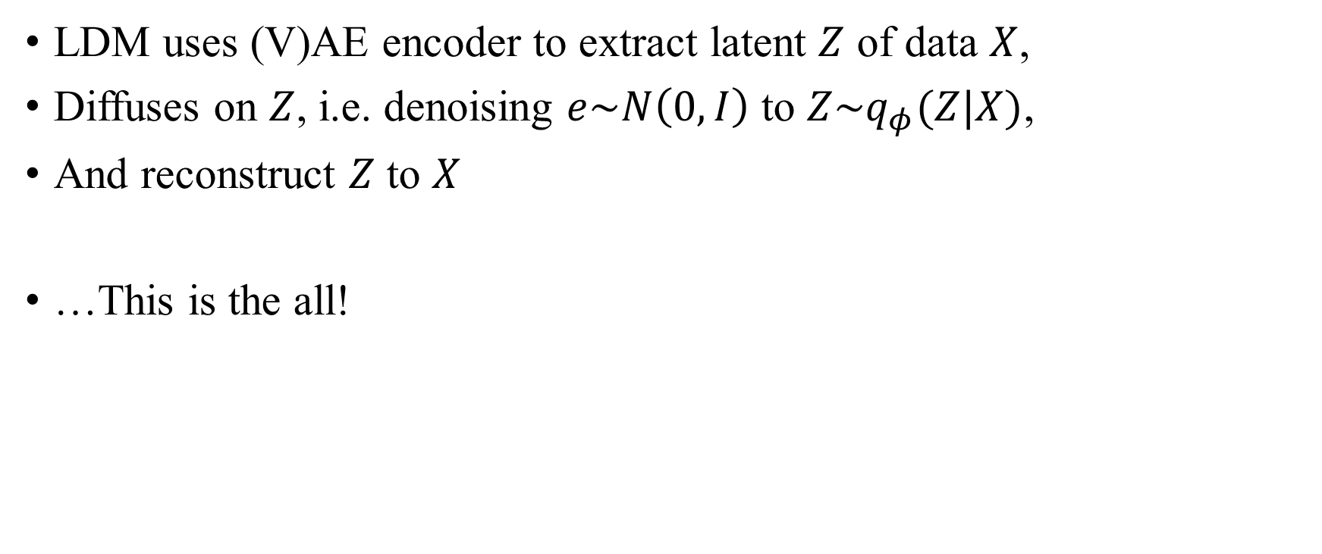
Why does LDM works well?
LDM uses (V)AE encoder to extract latent $Z$ of data $X$,
Diffuses on $Z$, i.e. denoising $e\sim N\left(0, I\right)$ to $Z\sim q_{φ}(Z|X)$,
And reconstruct $Z$ to $X$
…This is the all!

Slide 4
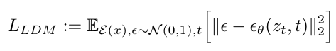
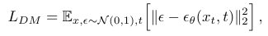
Why does LDM works well?
See LDM loss
There is nothing special about it compared to a typical diffusion model
This is even more true because the (V)AE is pretrained
This is the original diffusion model

Slide 5
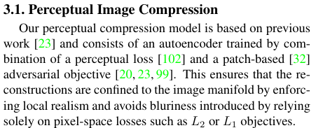
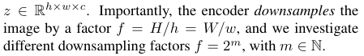
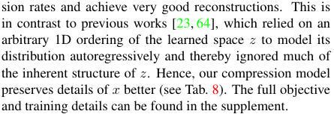
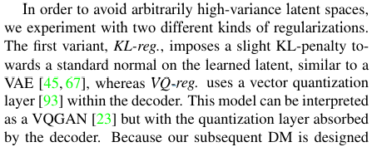
Details
Maintaining 2D structure
Might be important
Perceptual loss & Patch-based adversarial objective
Very technical; probably not important
But 1D latent space is just a rearrangement
Does it really matter?
The author claims it matters
KL from VAE, VQ from VQGAN
Both are very powerful loss,
But have been well studied already

Slide 6
My Claim
The performance of LDM depends on the distribution created by the outer regularized AE
This means that (V)AE alone can achieve excellent performance if we sample well

Slide 7
My Claim
LDM is just a (V)AE with veeeerrry powerful posterior sampler
Make sufficiently complex latent distribution and its sampler
Possible Solution:
1. Strengthens the encoder
Is something more possible than using full covariance?
2. Enhance sampling (like LDM)
Assuming the decoder is just fine!!!

Slide 8
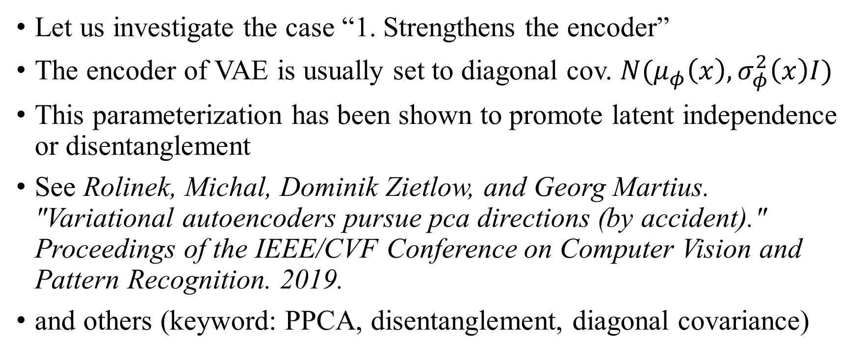
VAE with Diagonal Covariance
Let us investigate the case “1. Strengthens the encoder”
The encoder of VAE is usually set to diagonal cov. $N(μ_{φ}\left(x\right), σ_{φ}^{2}\left(x\right)I)$
This parameterization has been shown to promote latent independence or disentanglement
See Rolinek, Michal, Dominik Zietlow, and Georg Martius. "Variational autoencoders pursue pca directions (by accident)." Proceedings of the IEEE/CVF Conference on Computer Vision and Pattern Recognition. 2019.
and others (keyword: PPCA, disentanglement, diagonal covariance)

Slide 9
VAE with Diagonal Covariance
Recent research on VAE:
Shekhovtsov, Alexander, Dmitrij Schlesinger, and Boris Flach. "VAE approximation error: ELBO and exponential families." arXiv preprint arXiv:2102.09310 (2021).
The encoding distribution of VAE lacks capacity!
Even in the simple toy example, VAE fails to restore the original dist.
And this is largely the encoder’s fault!
Wipf, David. "Marginalization is not marginal: no bad VAE local minima when learning optimal sparse representations." International Conference on Machine Learning. PMLR, 2023.
VAE can restore the original distribution with
only a strong (i.e. full covariance) encoder and a very weak (i.e. linear) decoder!
We also show two theorem:
1. Increasing the decoder capacity does not improve performance at all
2. Limiting the encoder to conventional setting (i.e. diagonal covariance) diminishes its advantages and makes it identical to an autoencoder

Slide 10
VAE with Diagonal Covariance
It is okay for the decoder to have a small capacity
Rather, it is very surplus now
But the encoder is very weak in conventional setting
We are only using diagonal covariance!!

Slide 11
Rotating
Why cannot a more complex decoder solve this?
One can change an independent RV to a dependent RV by passing a function
Does having off-diagonal covariance mean more?
Scraped this from a previous indiv. meeting
Think about what is wrong with this claim

Slide 12
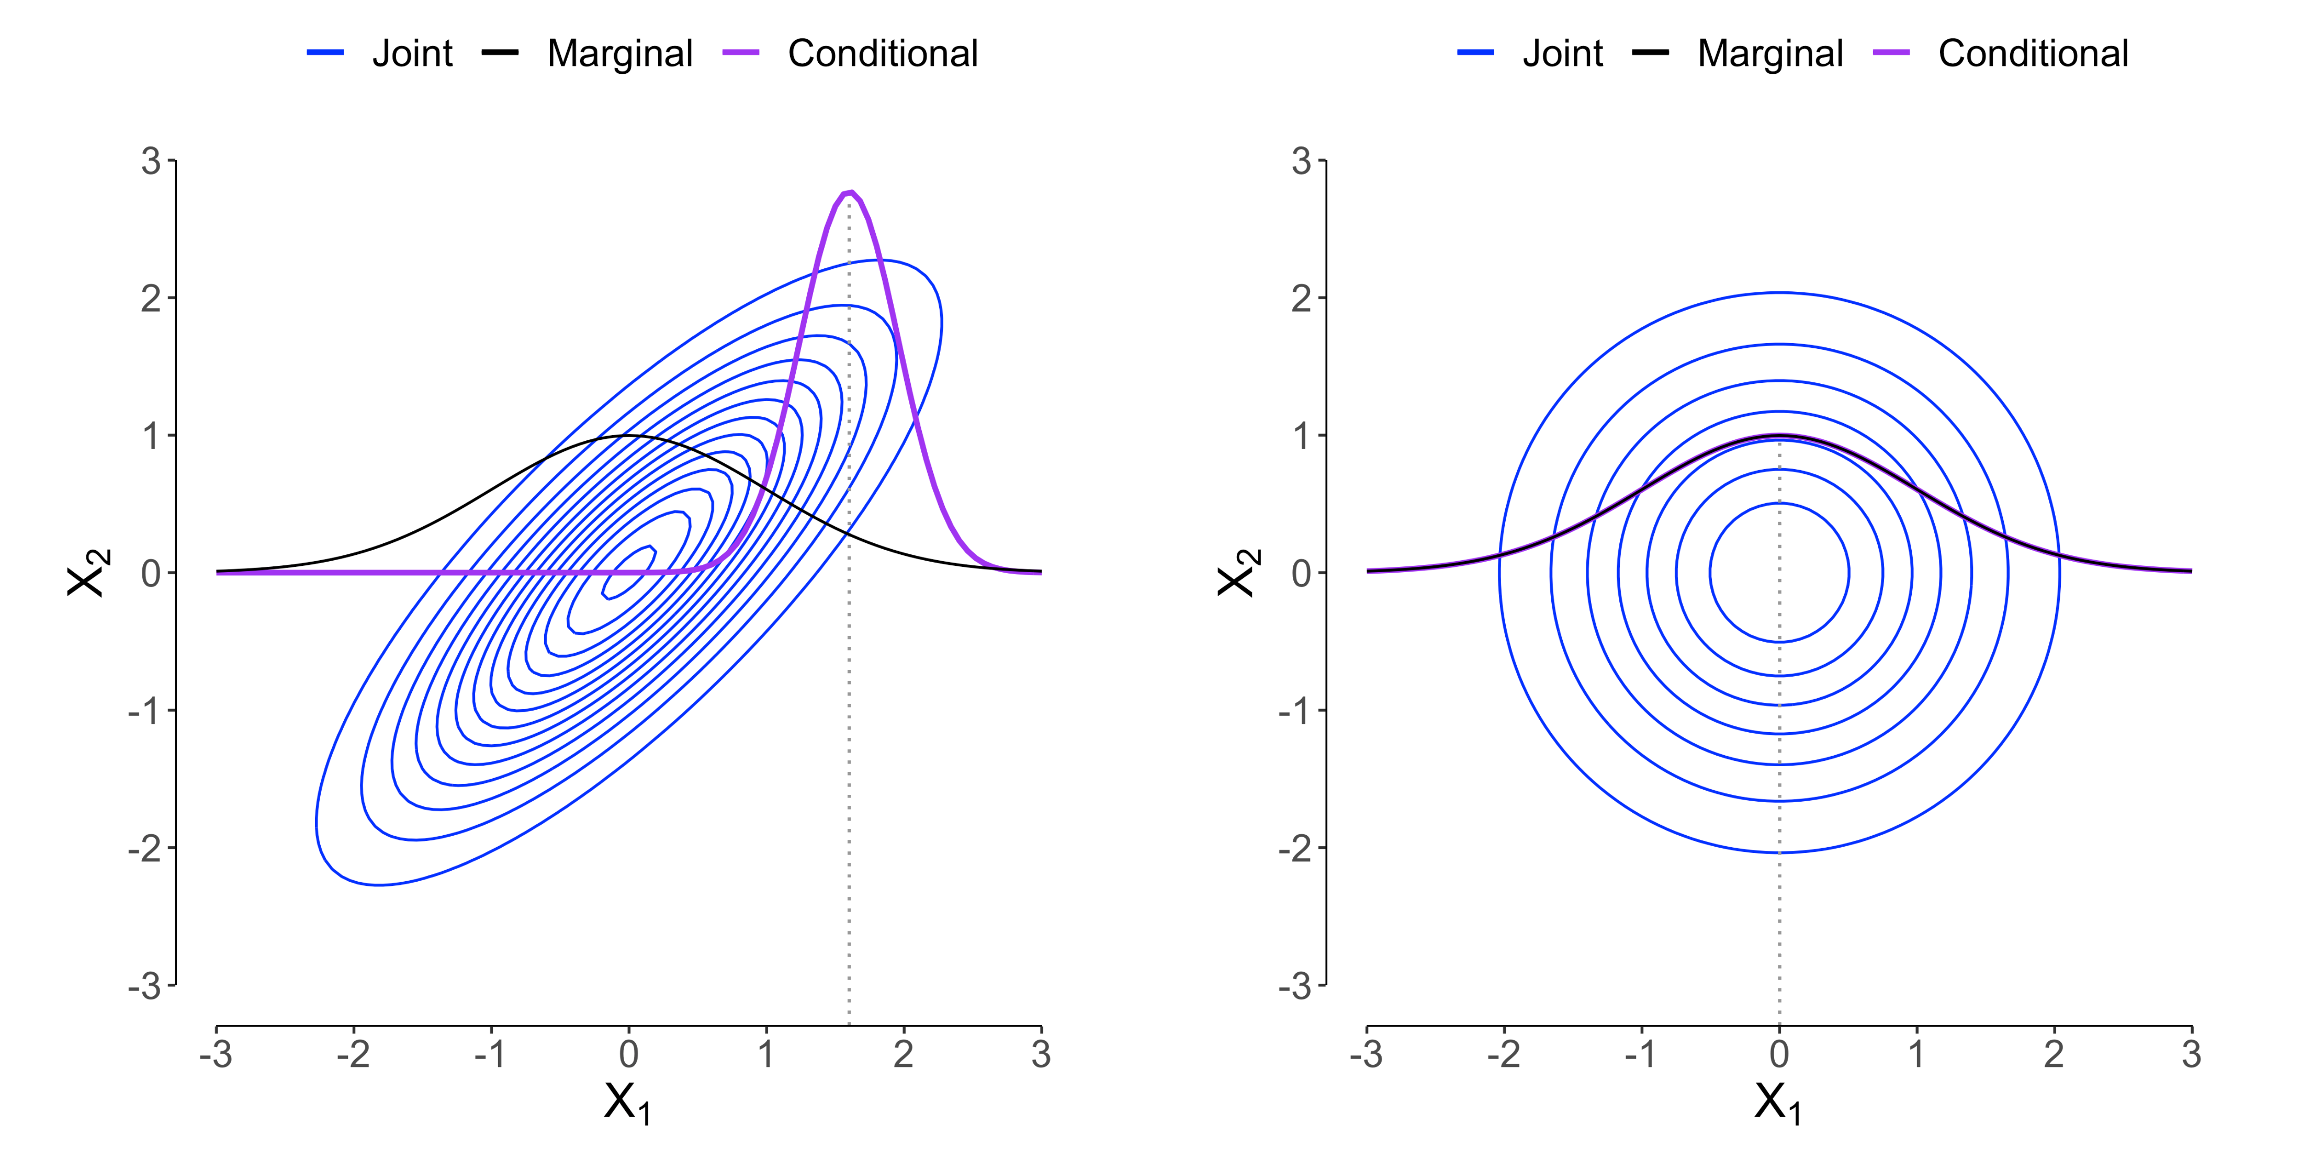
Rotating
This is possible, but not suitable for this situation
In fact, independent distributions can be made dependent by rotating them along the variable axis

Slide 13
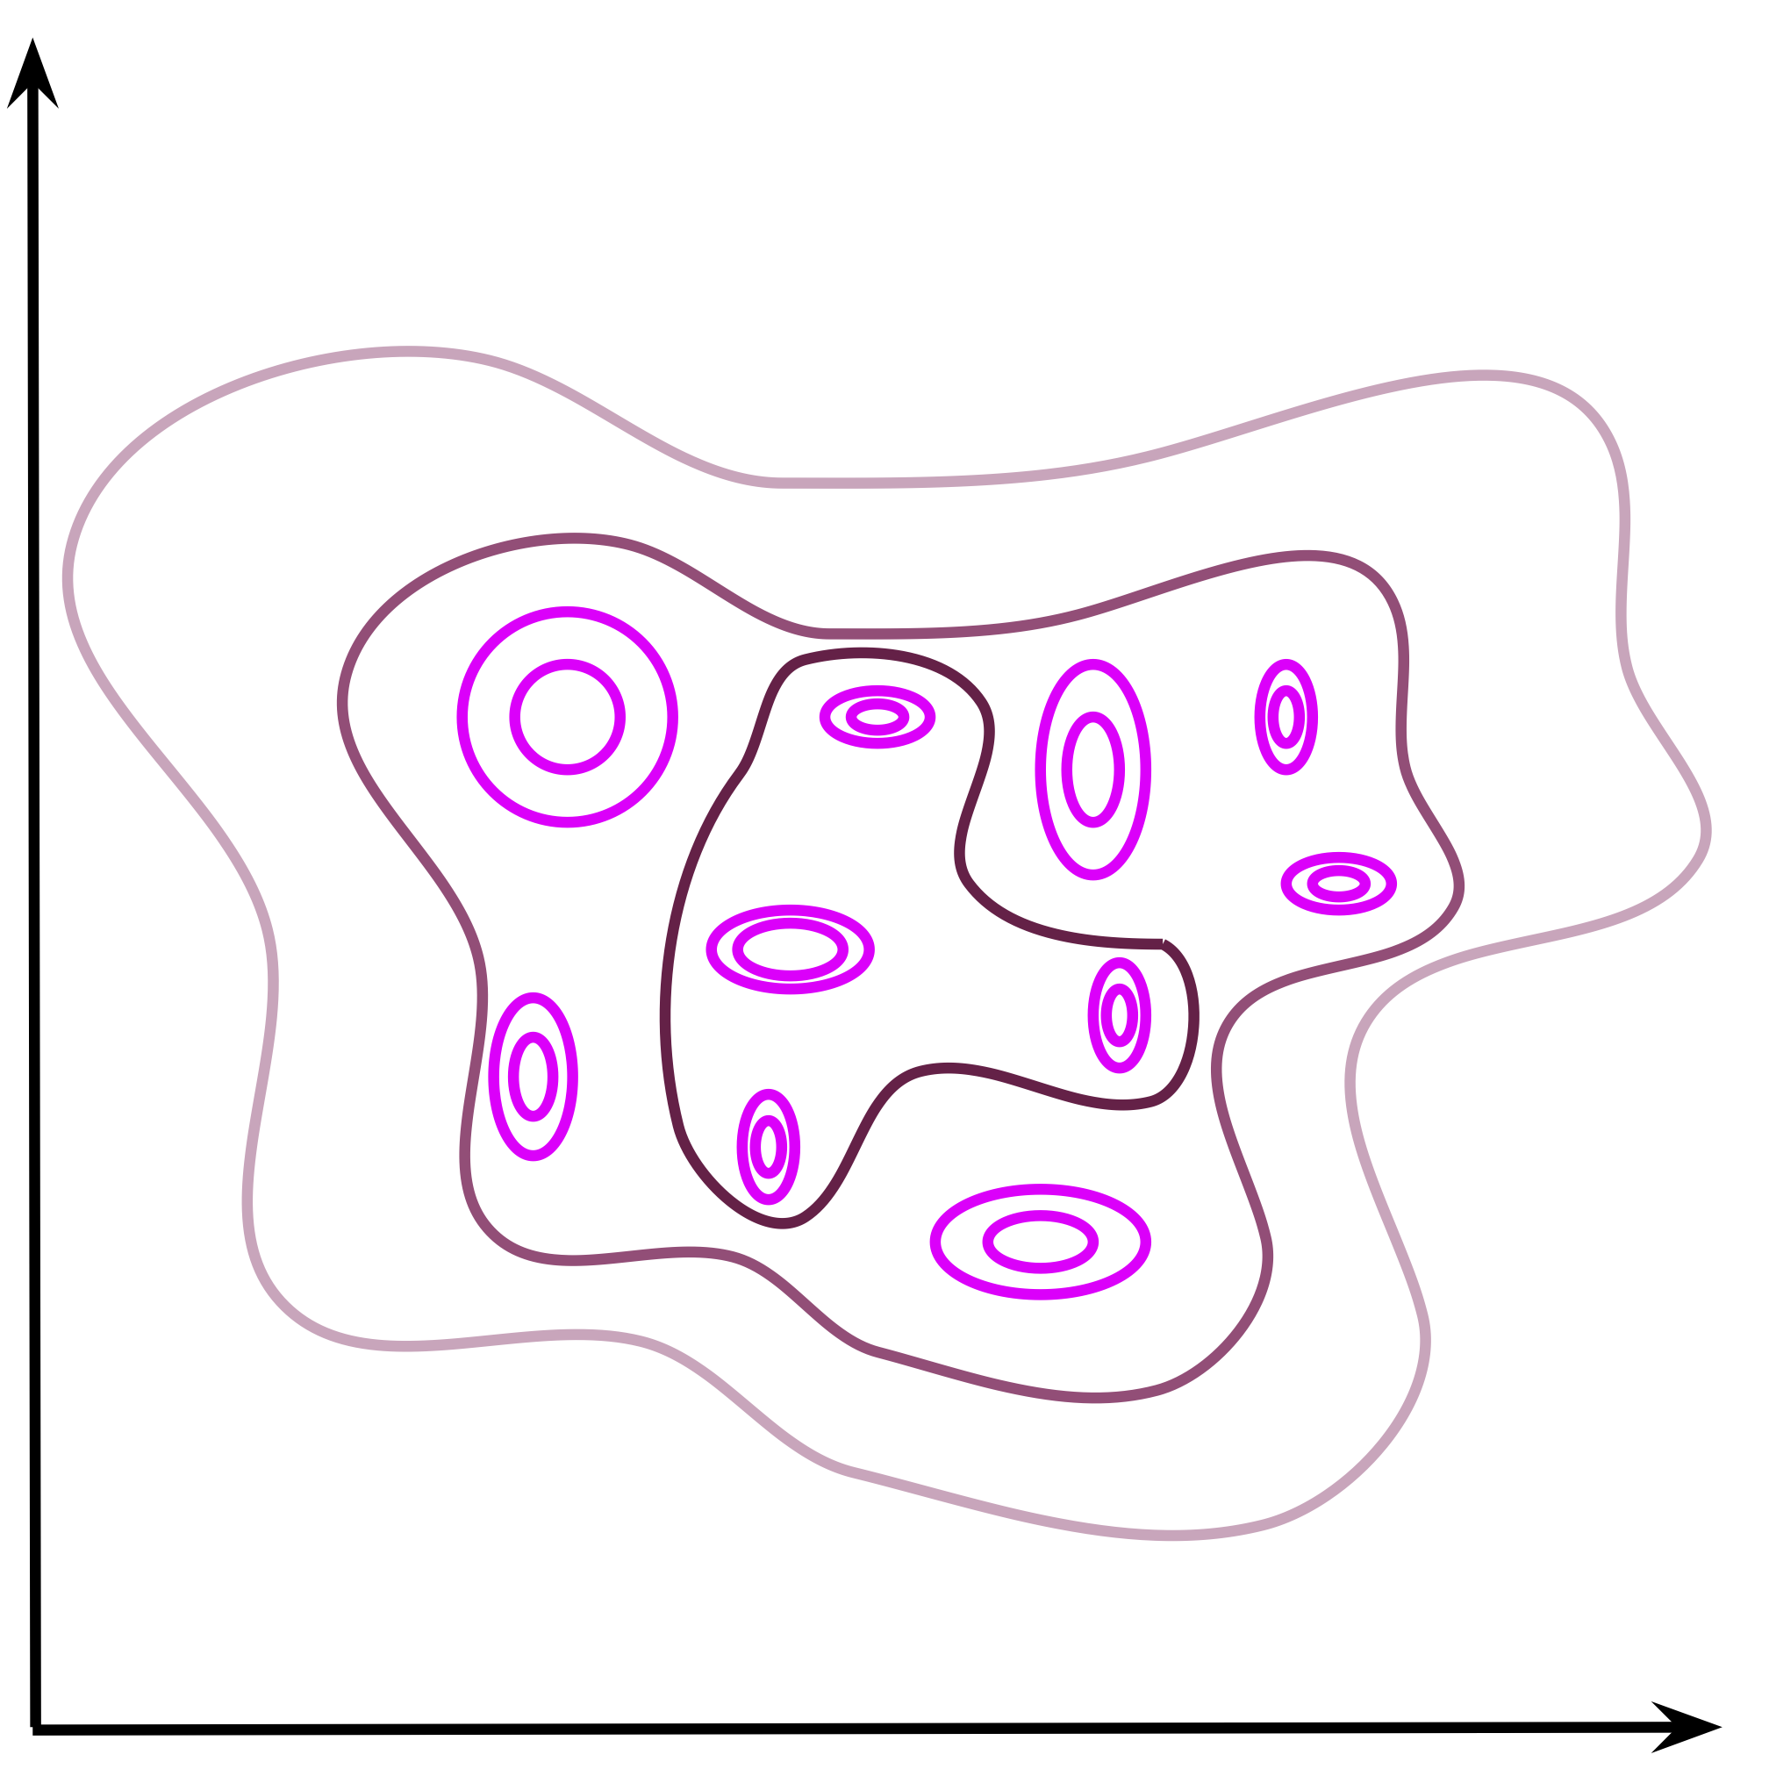
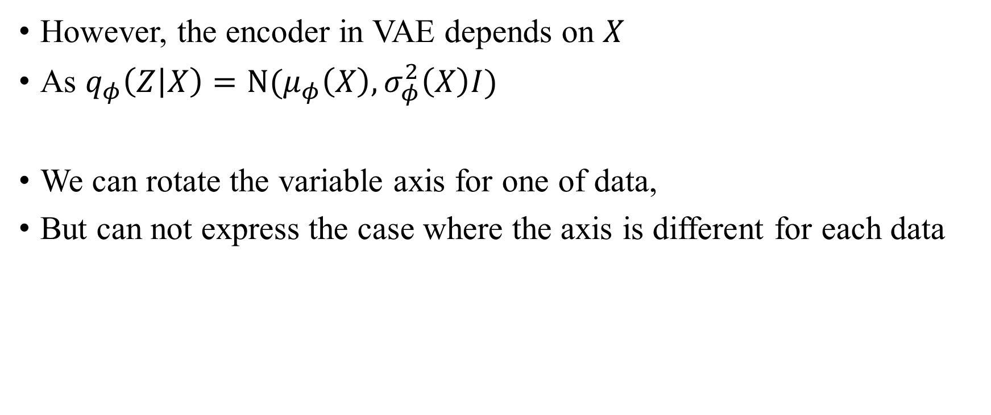
Rotating
However, the encoder in VAE depends on $X$
As $q_{φ}\left(Z | X\right)=N(μ_{φ}\left(X\right), σ_{φ}^{2}\left(X\right)I)$
We can rotate the variable axis for one of data,
But can not express the case where the axis is different for each data

Slide 14
Full Covariance
Anyway, we show that the full covariance has an advantage
So how should we implement it..?
One should not just parameterize it with an arbitrary matrix
The covariance matrix has various constraints
1. Symmetric matrix
2. Positive semidefinite

Slide 15
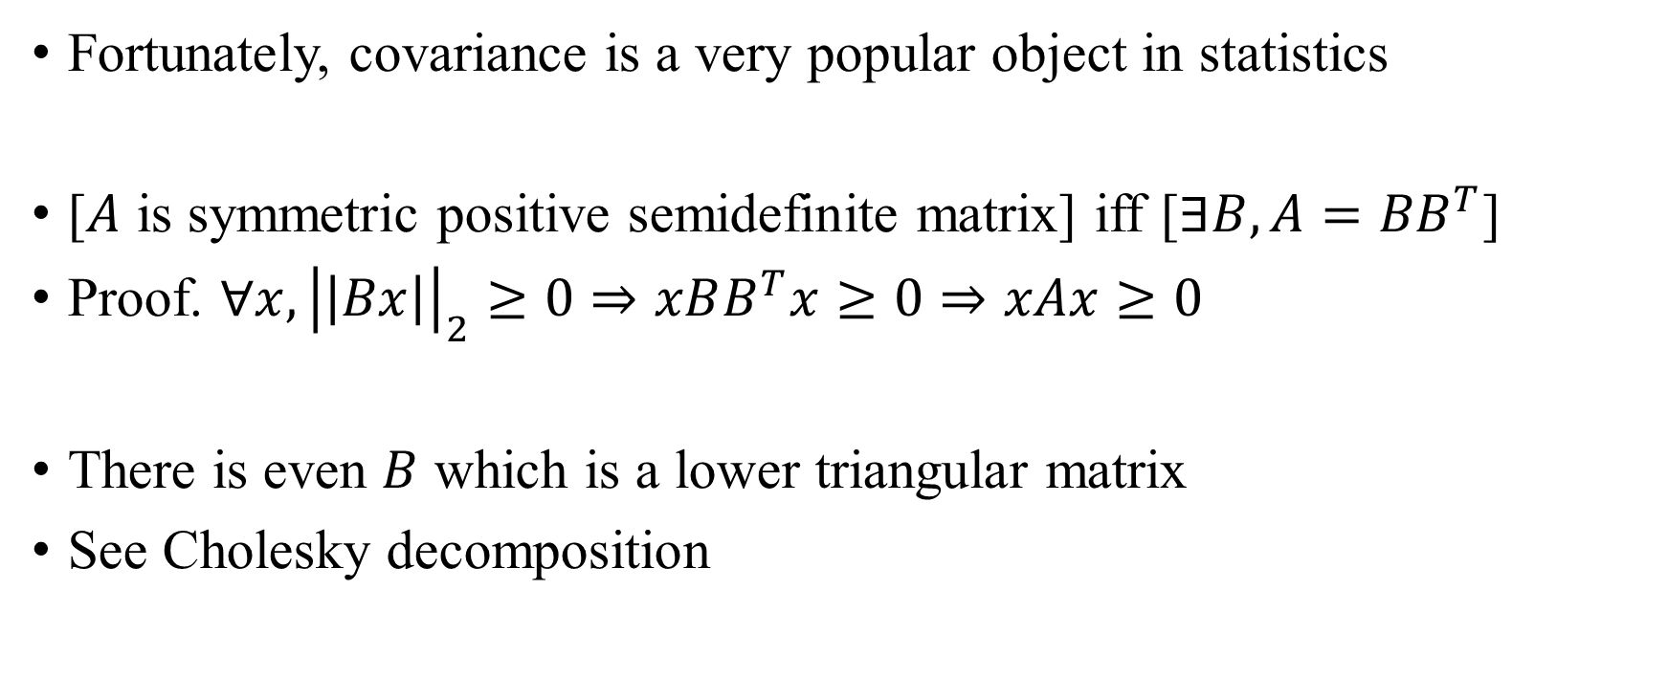
Full Covariance
Fortunately, covariance is a very popular object in statistics
[$A$ is symmetric positive semidefinite matrix] iff [$∃B, A={BB}^{T}$]
Proof. $∀x, {\left|\left|Bx\right|\right|}_{2}≥0⇒xBB^{T}x≥0⇒xAx≥0$
There is even $B$ which is a lower triangular matrix
See Cholesky decomposition

Slide 16
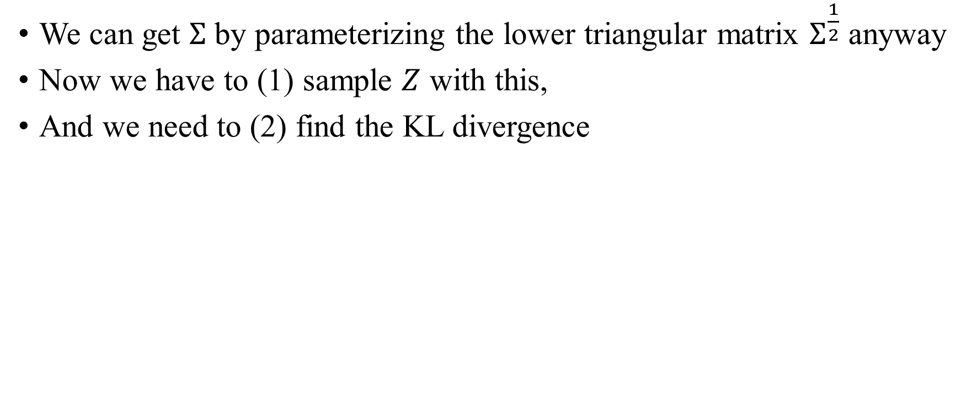
Full Covariance
We can get $Σ$ by parameterizing the lower triangular matrix $Σ^{\frac{1}{2}}$ anyway
Now we have to (1) sample $Z$ with this,
And we need to (2) find the KL divergence

Slide 17
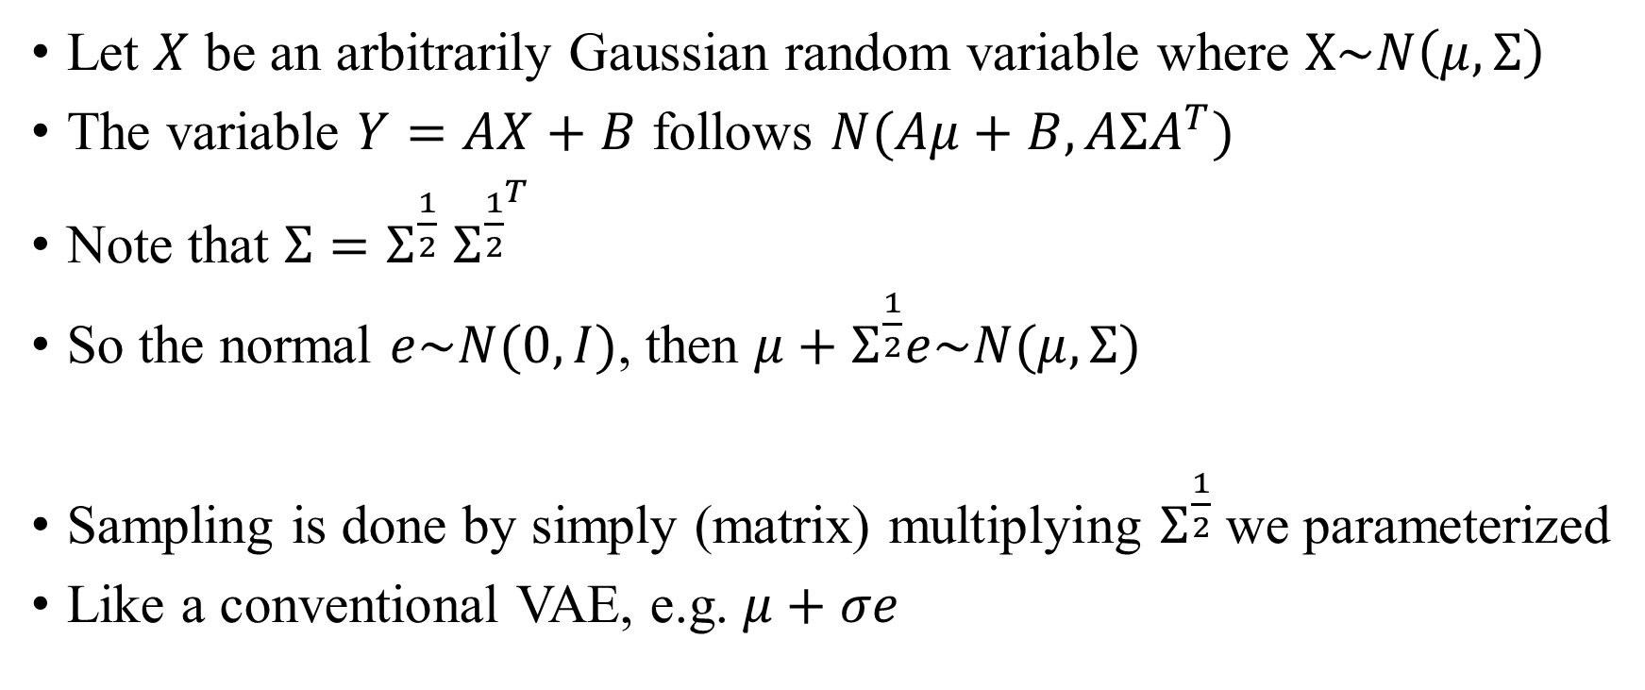
Implementation
Let $X$ be an arbitrarily Gaussian random variable where $X\sim N\left(μ,Σ\right)$
The variable $Y=AX+B$ follows $N(Aμ+B,AΣA^{T})$
Note that $Σ=Σ^{\frac{1}{2}}$ $Σ^{{\frac{1}{2}}^{T}}$
So the normal $e\sim N(0,I)$, then $μ+Σ^{\frac{1}{2}}e\sim N(μ,Σ)$
Sampling is done by simply (matrix) multiplying $Σ^{\frac{1}{2}}$we parameterized
Like a conventional VAE, e.g. $μ+σe$

Slide 18
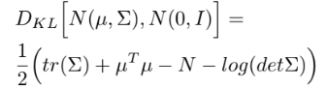
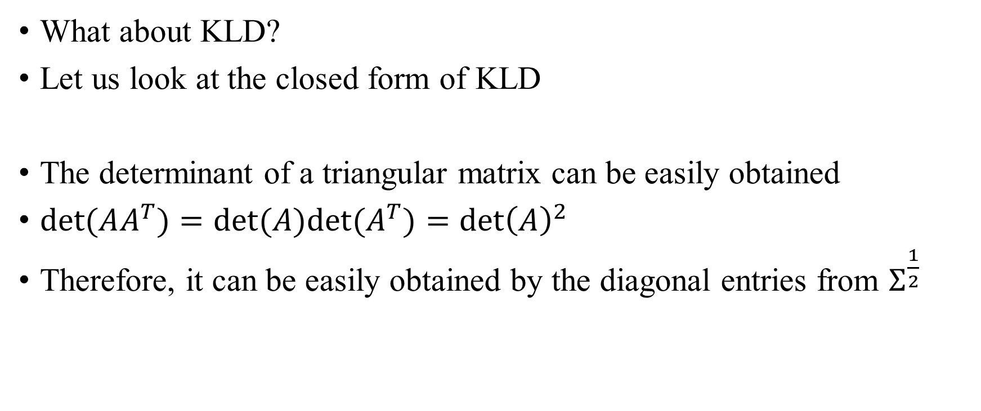
Implementation
What about KLD?
Let us look at the closed form of KLD
The determinant of a triangular matrix can be easily obtained
$det⁡(AA^{T})=det⁡(A)det⁡(A^{T})={\det\left(A\right)}^{2}$
Therefore, it can be easily obtained by the diagonal entries from $Σ^{\frac{1}{2}}$

Slide 19
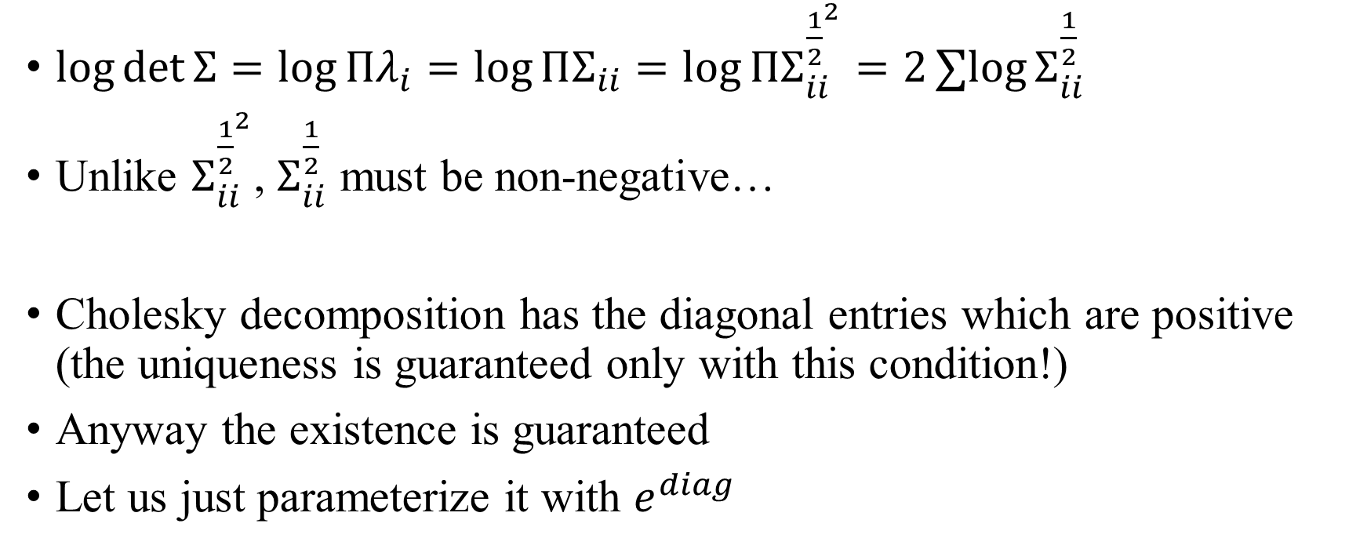
Implementation
$\log{\det{Σ}}=\log{Πλ_{i}=\log{ΠΣ_{ii}}}=\log{ΠΣ_{ii}^{{\frac{1}{2}}^{2}}}=2∑log{Σ_{ii}^{\frac{1}{2}}}$
Unlike $Σ_{ii}^{{\frac{1}{2}}^{2}}$, $Σ_{ii}^{\frac{1}{2}}$ must be non-negative…
Cholesky decomposition has the diagonal entries which are positive (the uniqueness is guaranteed only with this condition!)
Anyway the existence is guaranteed
Let us just parameterize it with $e^{diag}$

Slide 20
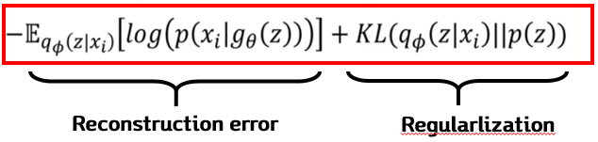
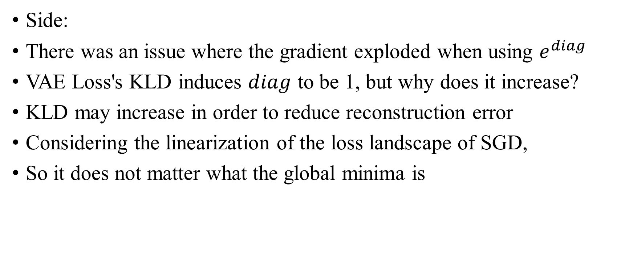
Implementation
Side:
There was an issue where the gradient exploded when using $e^{diag}$
VAE Loss's KLD induces $diag$ to be 1, but why does it increase?
KLD may increase in order to reduce reconstruction error
Considering the linearization of the loss landscape of SGD,
So it does not matter what the global minima is

Slide 21
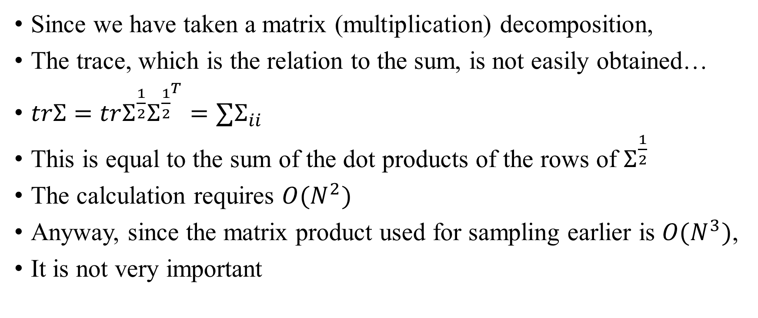
Implementation
Since we have taken a matrix (multiplication) decomposition,
The trace, which is the relation to the sum, is not easily obtained…
$trΣ=trΣ^{\frac{1}{2}}Σ^{{\frac{1}{2}}^{T}}=∑Σ_{ii}$
This is equal to the sum of the dot products of the rows of $Σ^{\frac{1}{2}}$
The calculation requires $O(N^{2})$
Anyway, since the matrix product used for sampling earlier is $O(N^{3})$,
It is not very important

Slide 22
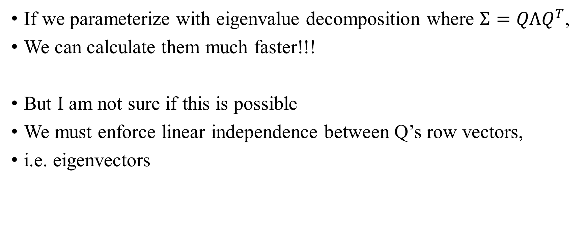
Implementation
If we parameterize with eigenvalue decomposition where $Σ=QΛQ^{T}$,
We can calculate them much faster!!!
But I am not sure if this is possible
We must enforce linear independence between Q’s row vectors,
i.e. eigenvectors

Slide 23
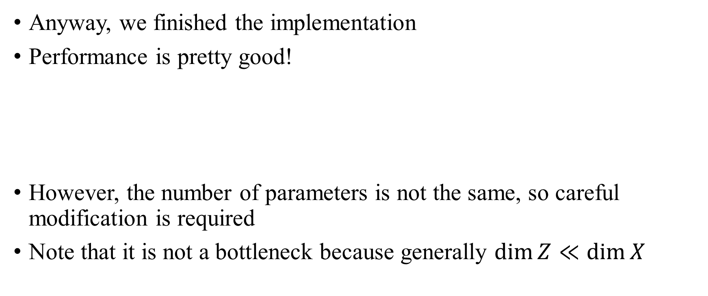
Experimental Result
Anyway, we finished the implementation
Performance is pretty good!
However, the number of parameters is not the same, so careful modification is required
Note that it is not a bottleneck because generally $\dim{Z}≪\dim{X}$

Slide 24
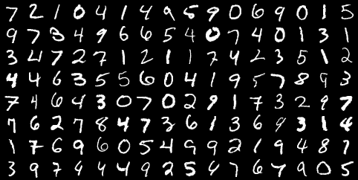


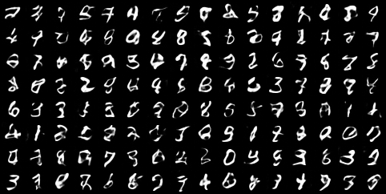
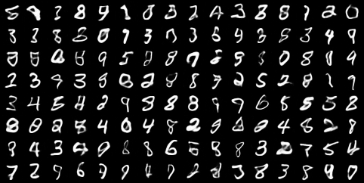
Experimental Result
MNIST
FID: 29
FID: 17

Slide 25
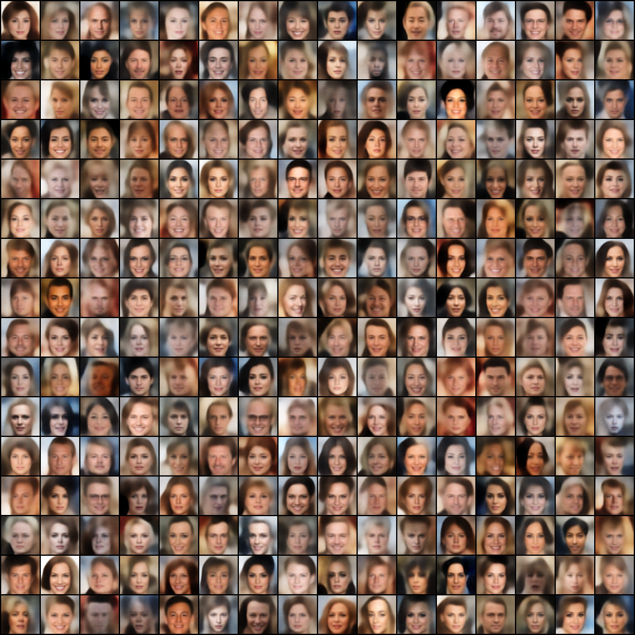
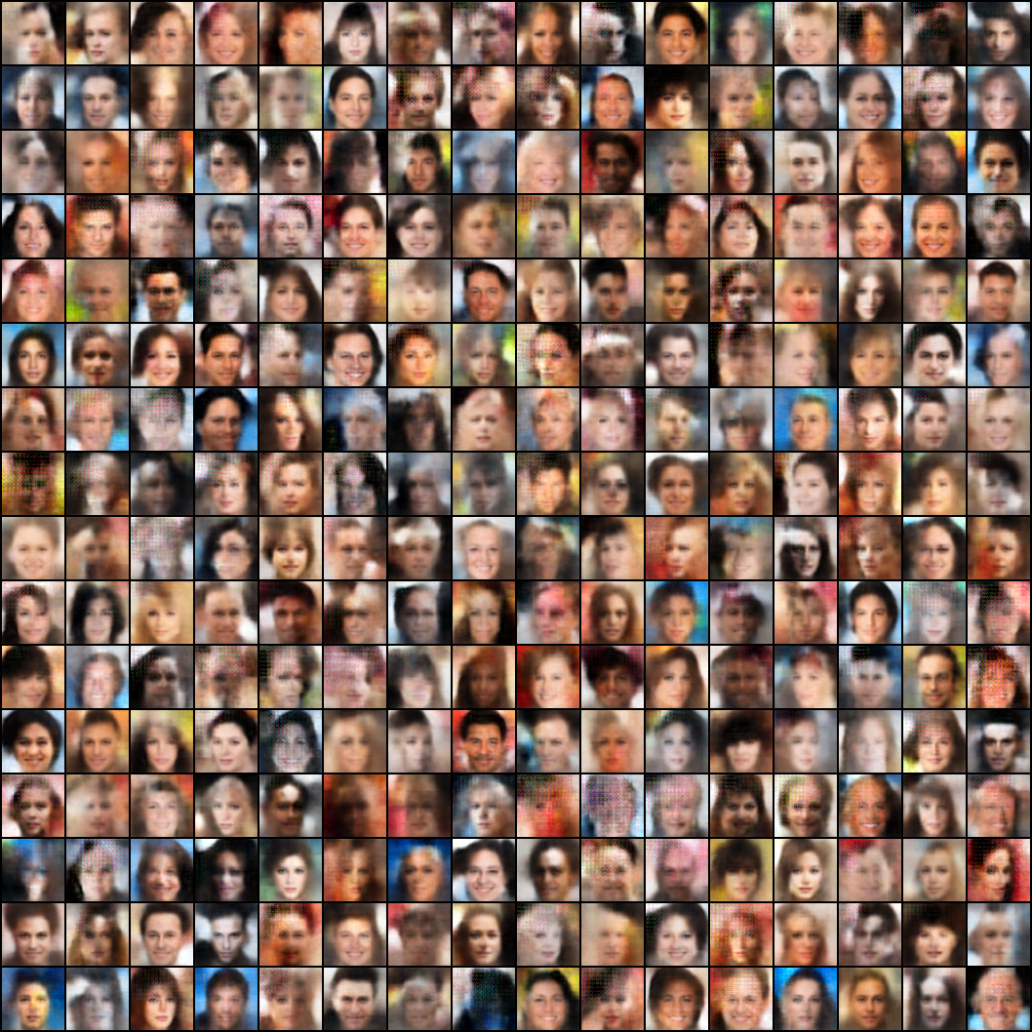
Experimental Result
CelebA

Slide 26
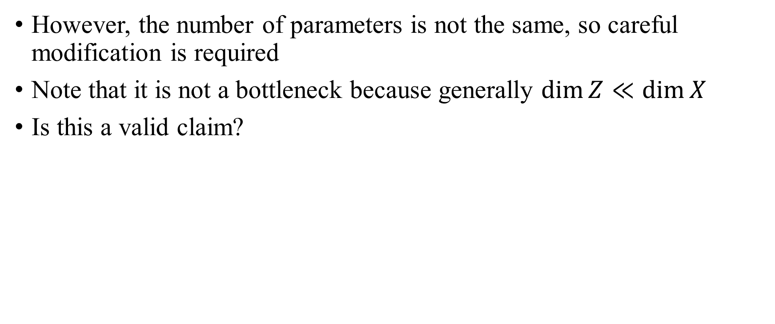
Experimental Result
However, the number of parameters is not the same, so careful modification is required
Note that it is not a bottleneck because generally $\dim{Z}≪\dim{X}$
Is this a valid claim?

Slide 27
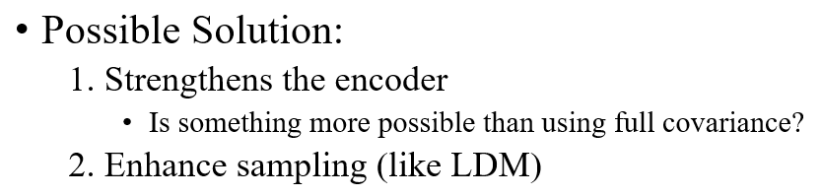
Enhance Sampling
Ok now we discuss sampling
In fact, sampling has been studied a great deal
e.g.
2-step VAE
VAE with Vamprior (trainable GMM prior)
VAE with Flow
VAE with GAN
VAE with Diffusion (i.e. LDM)
etc...

Slide 28
TODO
Plan to achieve good performance with VAE alone by incorporating existing sampling techniques into Full Covariance VAE
Check whether the performance is good with only the VAE in LDM (I wonder why this was not provided in the paper)

Slide 29
Thank you for listening
Presenter: Kim Seung Hwan (overnap@khu.ac.kr)

